Slide 1







ALU
Design for Arithmetic Logic Unit 4Bit

Slide 2


What Is The (ALU) ?
ALU stands for Arithmetic Logic Unit, a fundamental part of a computer's CPU (Central Processing Unit). The ALU is responsible for performing arithmetic operations (like addition, subtraction, multiplication, and division) and logical operations (such as comparisons and bitwise operations).
It is essentially the "brain within the brain" of a computer, handling the actual computation tasks as part of processing instructions.

Slide 3
Key Functions of the ALU
Arithmetic Operations
Logical Operations
Data Movement and Manipulation
A
B
C

Slide 4
Arithmetic Operations
Addition
subtraction
multiplication and division

Slide 5
Logical Operations
Comparisons

Slide 6

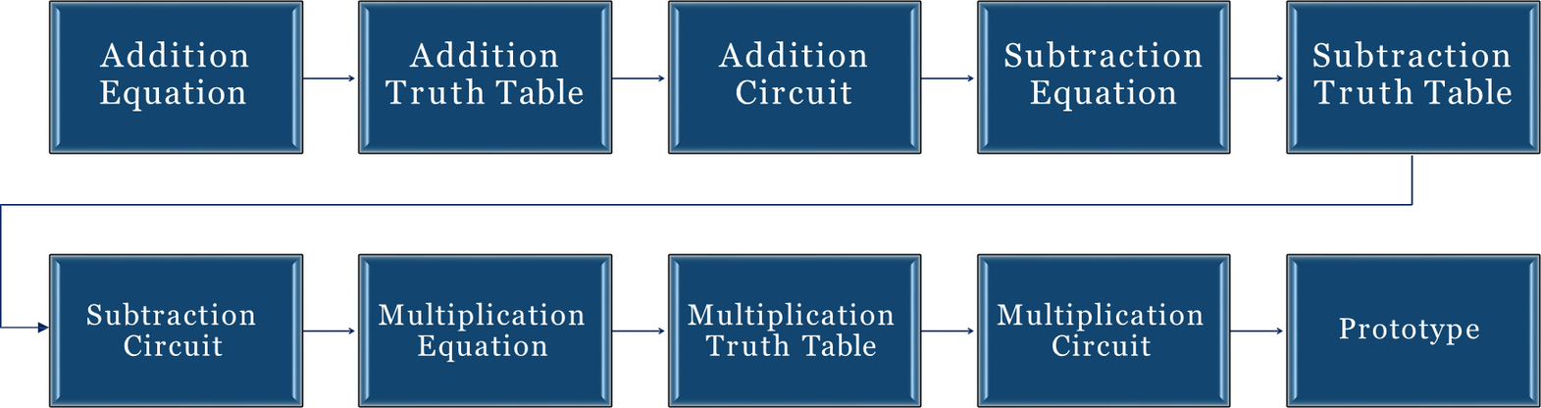
FLOWCHART

Slide 7

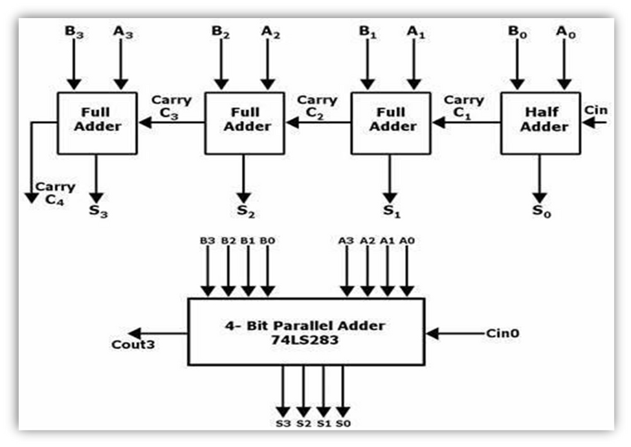
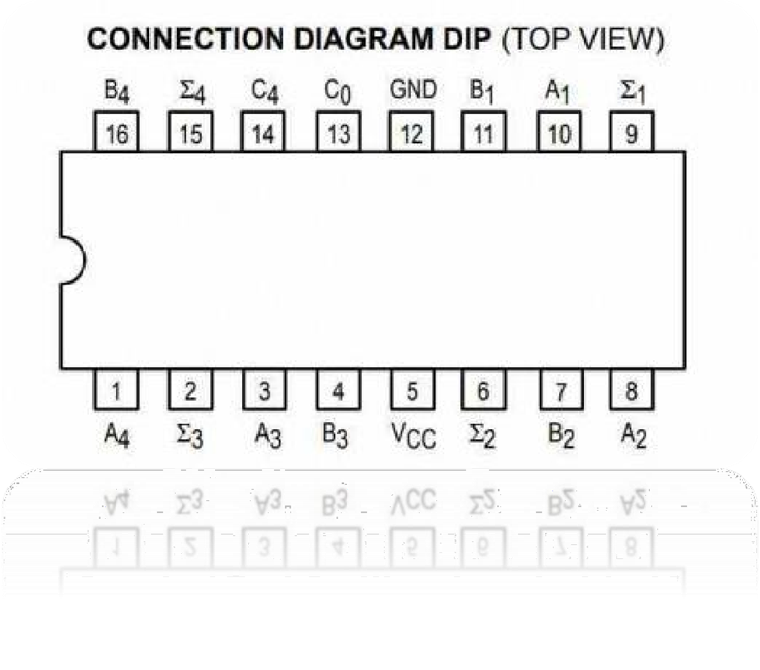
FULL ADDER IC 74LS83

Slide 8

SINGLE BITS FULL ADDER TRUTH TABLE
Truth Table for Single-Bit Full Adder with Cin = 0
A | B | Cin | Sum (S) | Cout
0 | 0 | 0 | 0 | 0
0 | 1 | 0 | 1 | 0
1 | 0 | 0 | 1 | 0
1 | 1 | 0 | 0 | 1
Simplified Logic for Cin = 0
1. Sum (S):
Sum = A ⊕ B (XOR operation between A and B)
2. Cout:
Cout = A ⋅ B (AND operation between A and B)

Slide 9

SINGLE BITS SUBTRACTOR TRUTH TABLE
Truth Table for Single-Bit Full Adder with Cin = 1
A | B | Bin | Diff (d) | Bout
0 | 0 | 0 | 0 | 0
0 | 1 | 0 | 1 | 1
1 | 0 | 0 | 1 | 0
1 | 1 | 0 | 0 | 0
Simplified Logic for Bin = 0
1. Difference (D):
D = A ⊕ B (XOR operation between A and B)
2. Borrow-out (Bout):
Bout = ¬A ⋅ B (NOT A AND B)

Slide 10
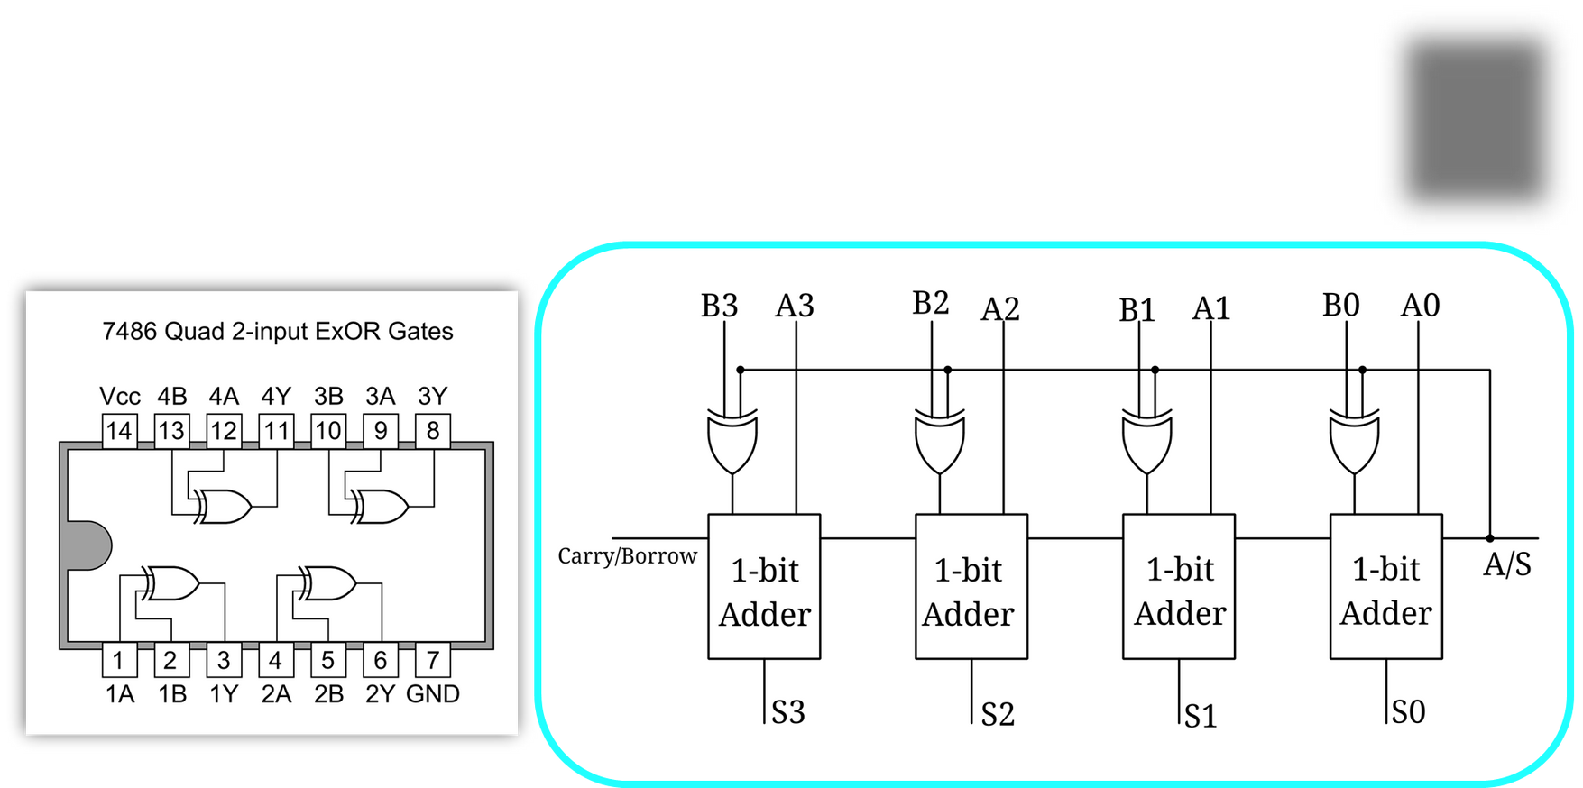
4-BITS SUBTRACTOR CIRCUIT

Slide 11
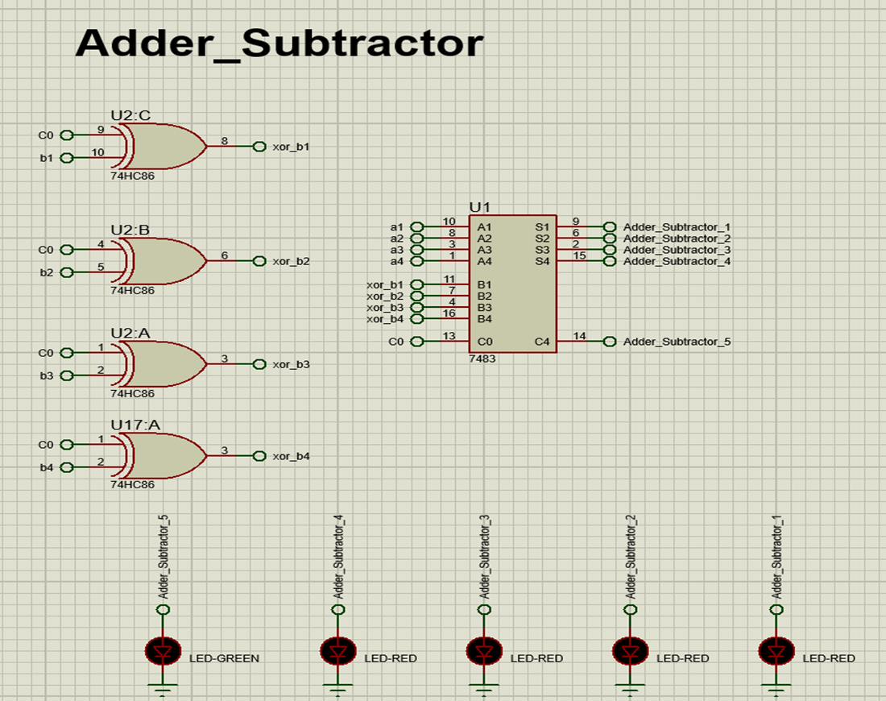
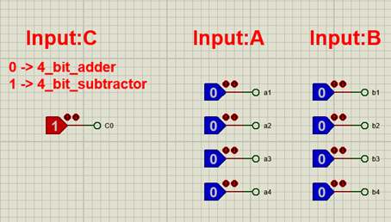
CIRCUIT

Slide 12
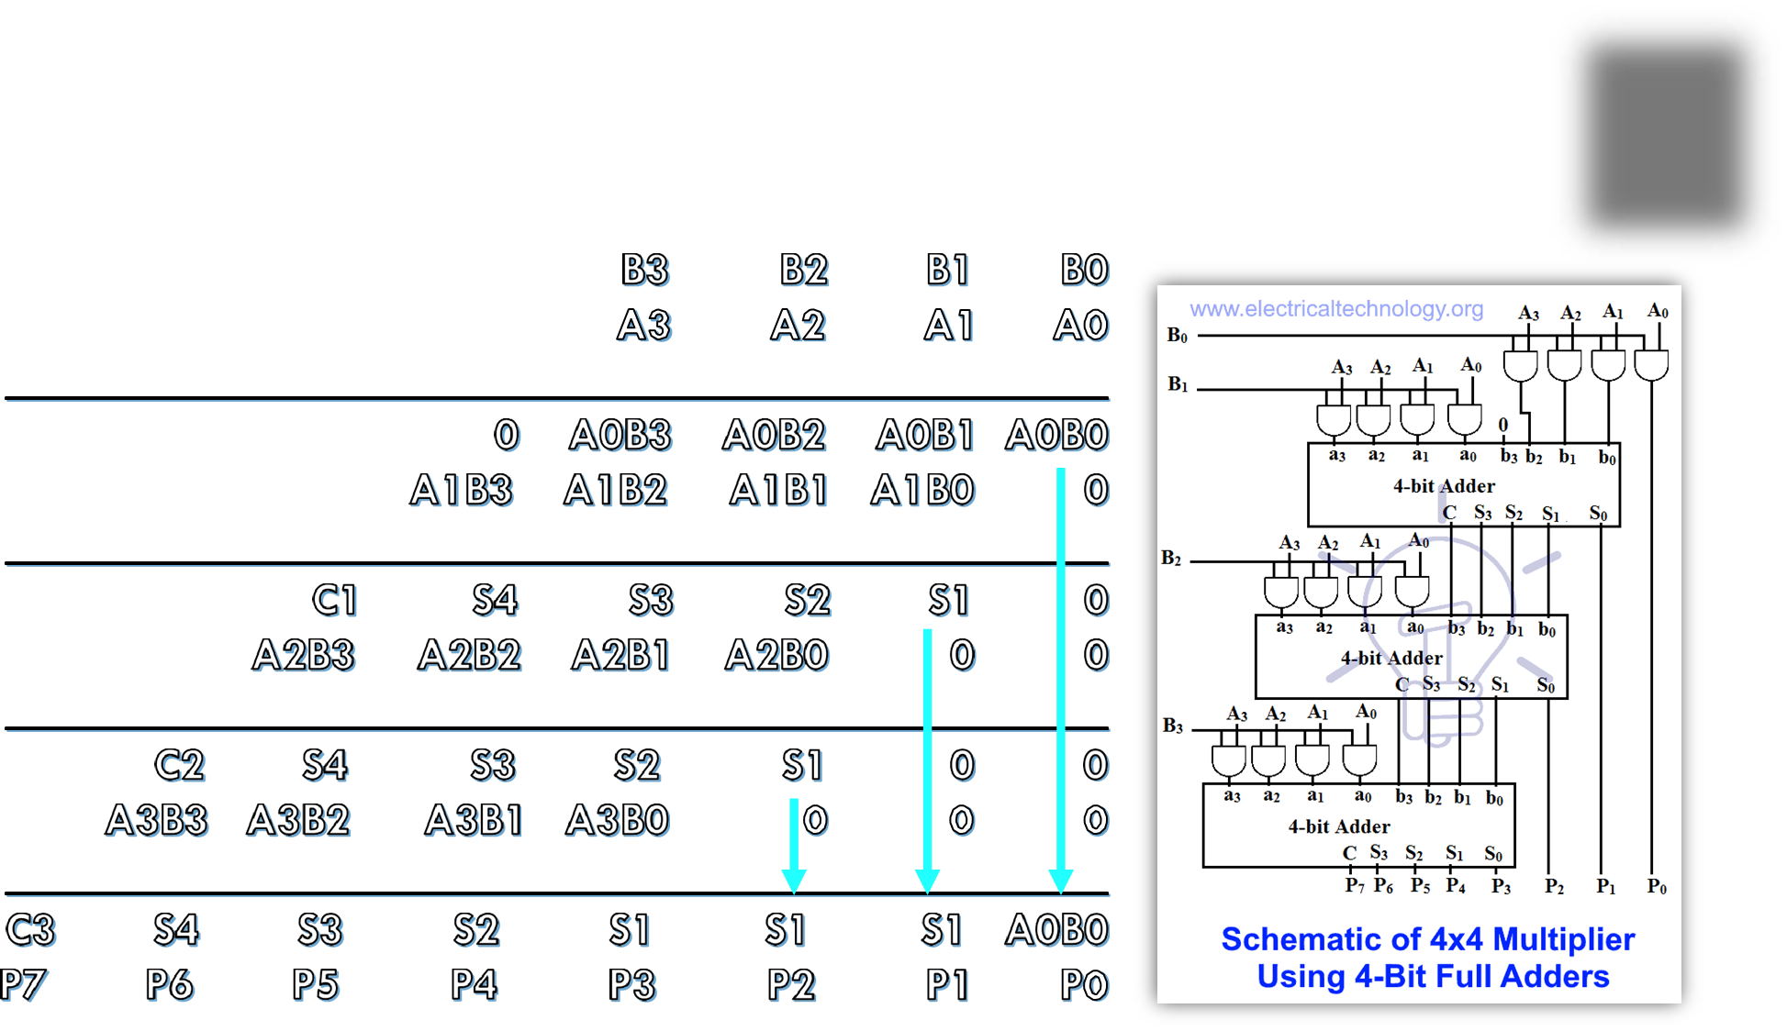
4-BITS MULTIPLICATOR EQUATION

Slide 13
4-BITS MULTIPLICATOR TRUTH TABLE
1.Inputs:
A (4 bits): Binary representation of one operand (A3-A2-A1-A0).
B (4 bits): Binary representation of the second operand (B3-B2-B1-B0​).
2. Output:
P (8 bits): Product (P7-P6-P5-P4-P3-P2-P1-P0​).

Slide 14
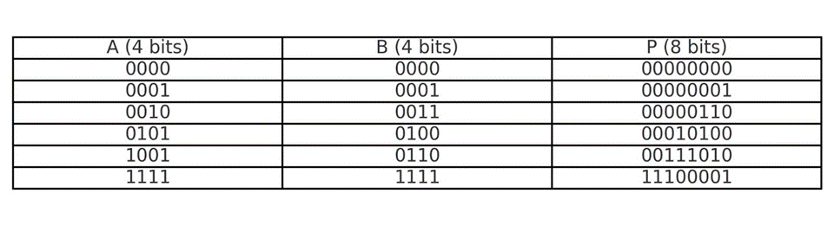
4-BITS MULTIPLICATOR TRUTH TABLE
Partial Truth Table Example:

Slide 15
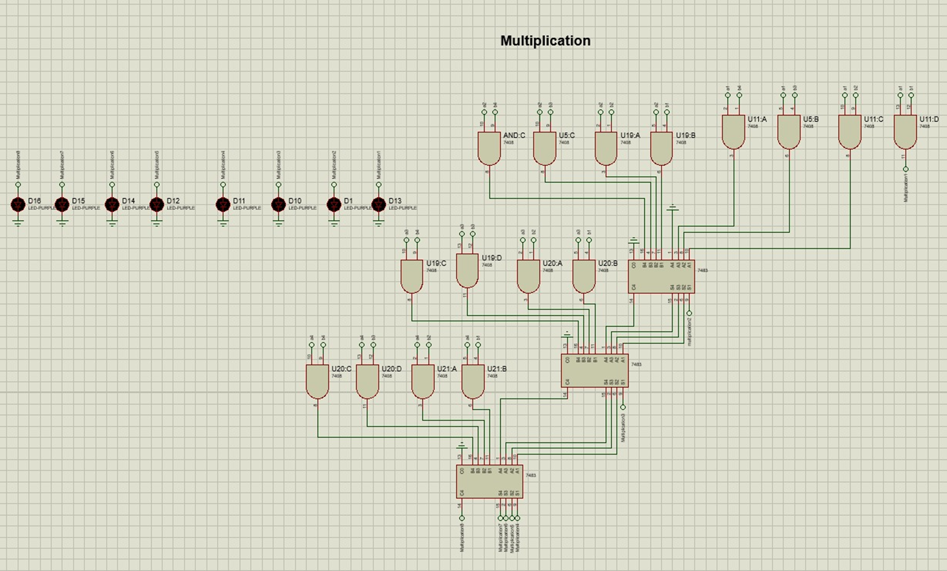
CIRCUIT

Slide 16
4-BITS COMPARATOR TRUTH TABLE
A 4-bit comparator circuit is a digital circuit designed to compare two 4-bit binary numbers (A and B) and determine their relative magnitude. The inputs A and Beach consist of four bits:
·A= (A3, A2, A1, A0) where A3 is the most significant bit (MSB), and A0 the least significant bit (LSB).
·B= (B3, B2, B1, B0)
Outputs:
The comparator produces three outputs to indicate the comparison result:
1.A>B: Output is high (1) if A is greater than B
2.A=B: Output is high (1) if A is equal to B
3.A<B: Output is high (1) if A is less than B

Slide 17
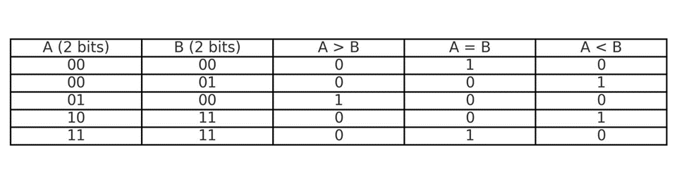
4-BITS COMPARATOR TRUTH TABLE
Partial Truth Table Example:

Slide 18
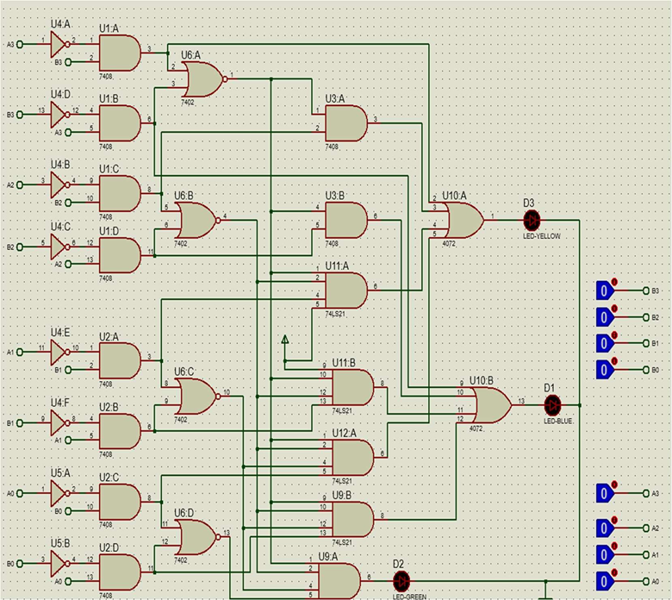
CIRCUIT
RESULTS
IF A equal B numbers are equal the green led will bright If A greater than B the blue led will bright
If A less than B the yellow led will bright

Slide 19
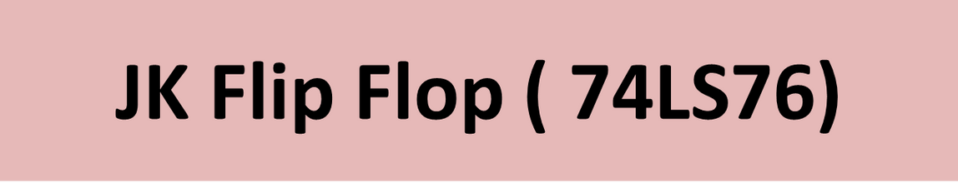
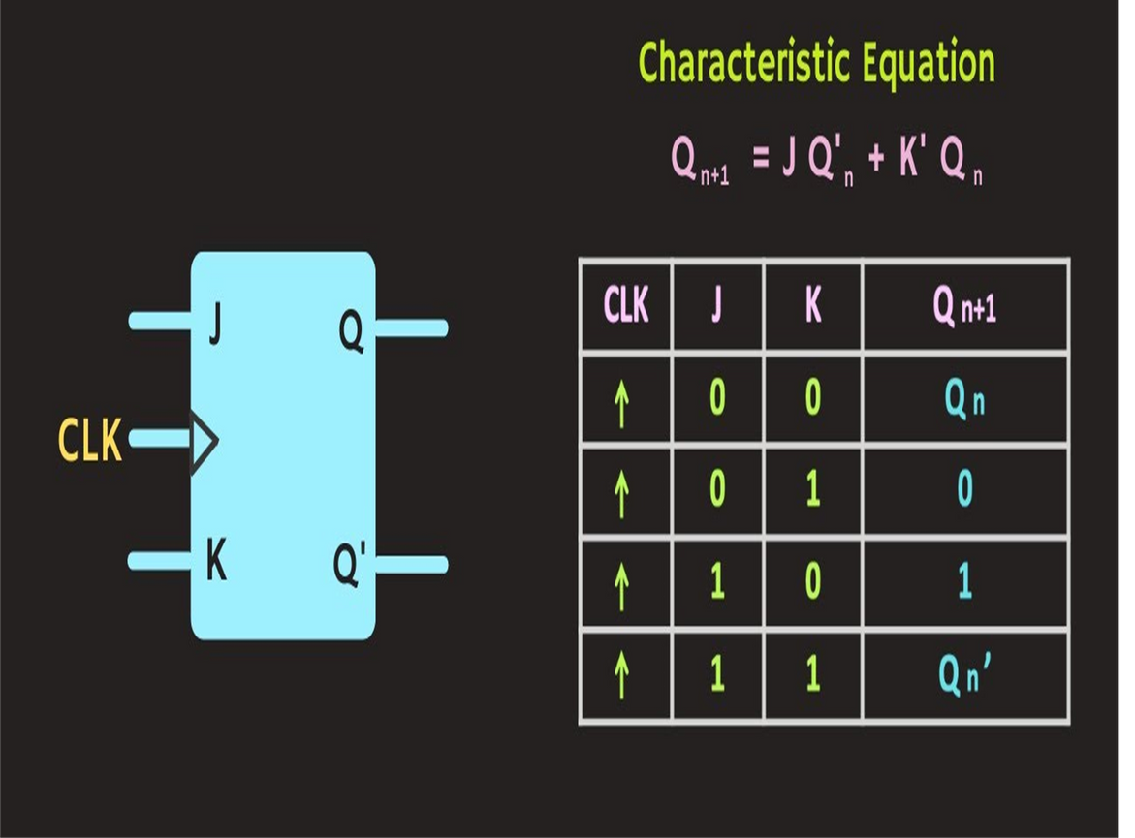

Slide 20
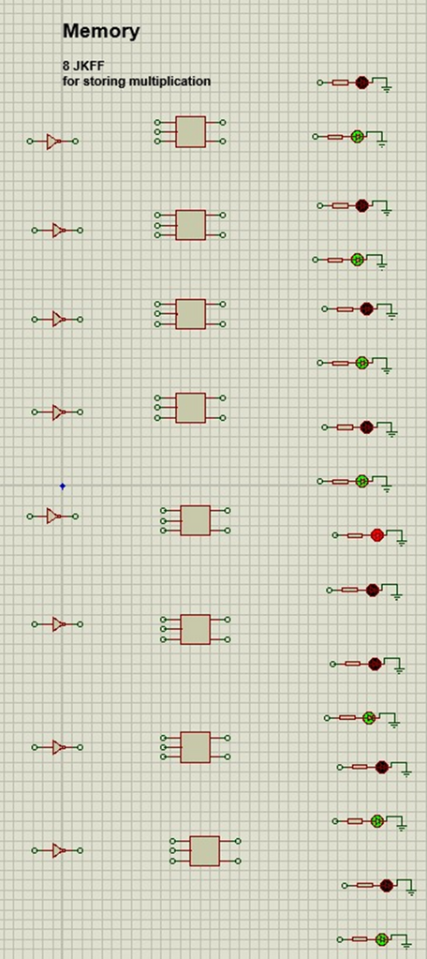
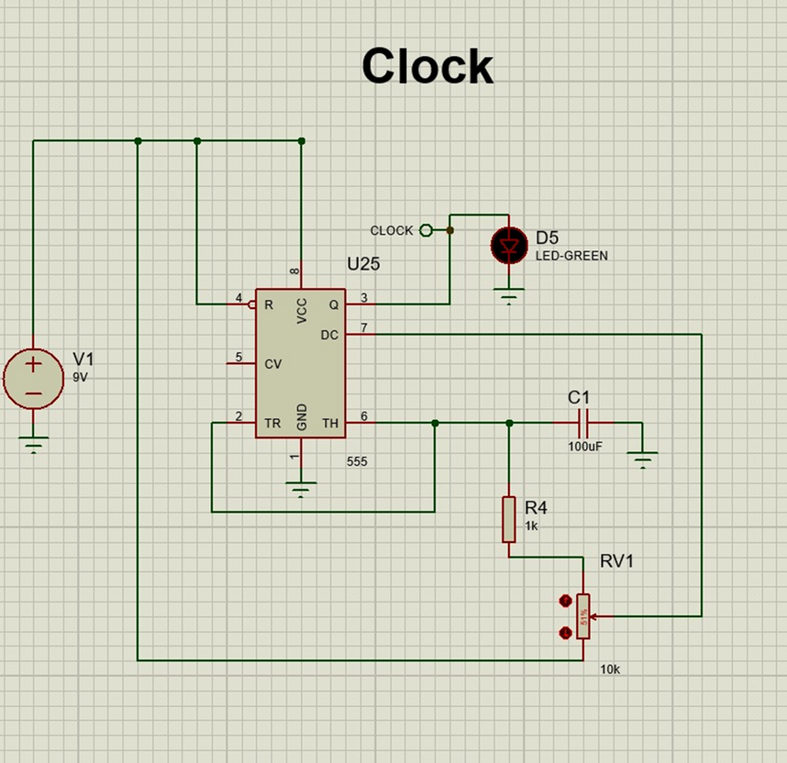
CIRCUIT

Slide 21
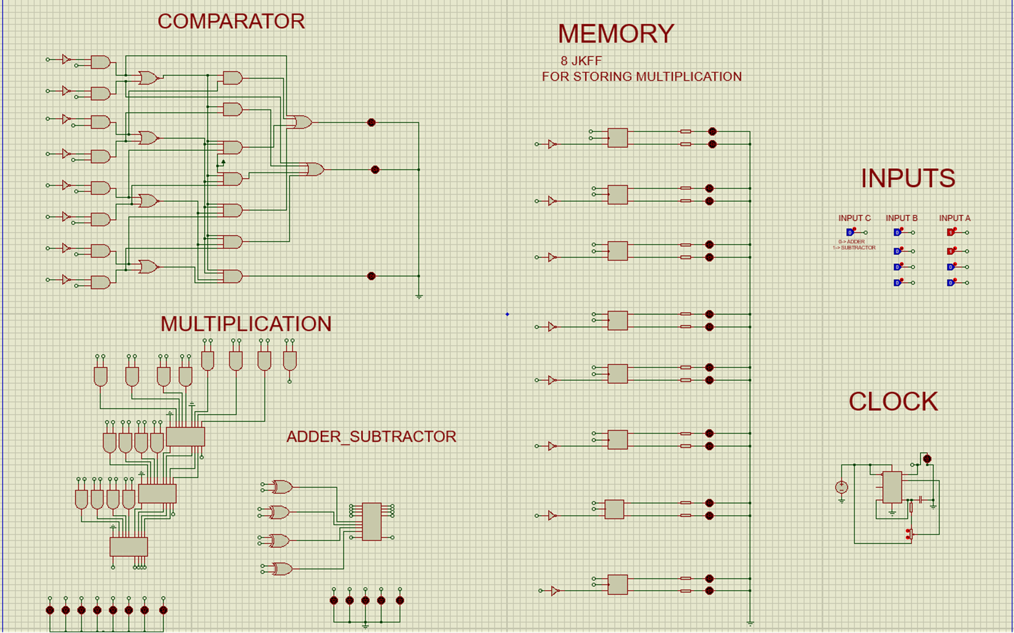
CIRCUIT FOR PROJECT

Slide 22
THANK YOU

